Slide 1
Predicting Ames House Prices via ML Techniques
Team Name: Fitting towards Ames

Slide 2
Value proposition
Most of us know about Zillow’s Zestimate but what’s in a Zestimate?
It’s relied on by millions of homeowners, real estate agents and investors
But transparency could be better
How well does it fit each local market? One complex model cannot rule all markets
Can we do better? Yes, atleast locally, for Ames.
We know Ames better, we focus only on real estate in Ames
Local expertise translated to models fit specifically to Ames housing market
Results speak for themselves:
Higher accuracy, greater transparency, better value for homeowners, real estate agents & investors.
*Zestimates are the weighted average sums of Active and Off market prediction results found at https://www.zillow.com/zestimate/
**Our model errors based on training data set only. Performance expected to be slightly lower on test(unseen data)
Level | Median Error | Within 5% of Sale Price | Within 10% of Sale Price | Within 20% of Sale Price
*Zestimate -- All US | 8% | 37% | 60% | 81%
Zestimate - State(Iowa) | 8% | 37% | 59% | 80%
Zestimate -- County(Story) | 7% | 44% | 68% | 87%
**Our Best Linear Model | 5% | 49% | 78% | 96%
**Our Best Non-Linear Model | 3% | 68% | 91% | 99%

Slide 3
Outline of Presentation
How did we achieve these results for the Ames housing market?
Brief description of data set
Exploratory data analysis – Getting to know the data through Visualizations
Preprocessing:
Missingness
Encoding, dummify
Transformations
Standardization
Feature engineering
The secret sauce: Model selection, parameter tuning, performance metrics:
Limited feature model(GAM)
Penalized Linear Models – Ridge, Lasso, Elastic-Net
Non-Linear Models – XGBoost
Ensemble Model – XGBoost + Ridge + Lasso
Insights:
Influential features
Action items addressing business problem
Conclusions and Further work

Slide 4
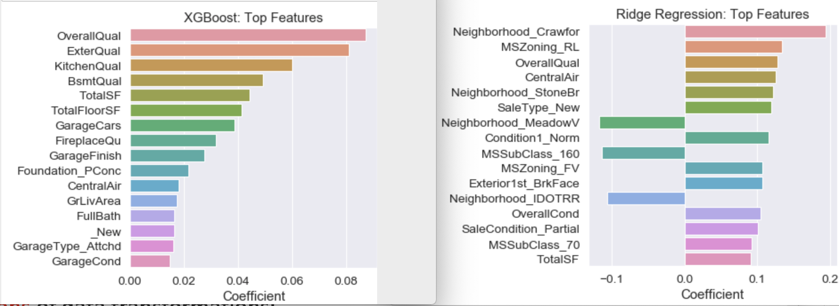
Insights – Value proposition
Local market knowledge + data science + machine leaning = Better results
However, what does all this mean for homeowners, real estate agents and investors in Ames?
What features influence home prices?
No surprises:- Overall home quality, condition and size are strong positives
Interestingly in Ames having Central Air condition is a big plus!
You pay a premium for living in Crawford, Stone Brook.
Conversely homes in Meadow Village, Iowa DOT and Rail Road sell at a relative discount.

Slide 5
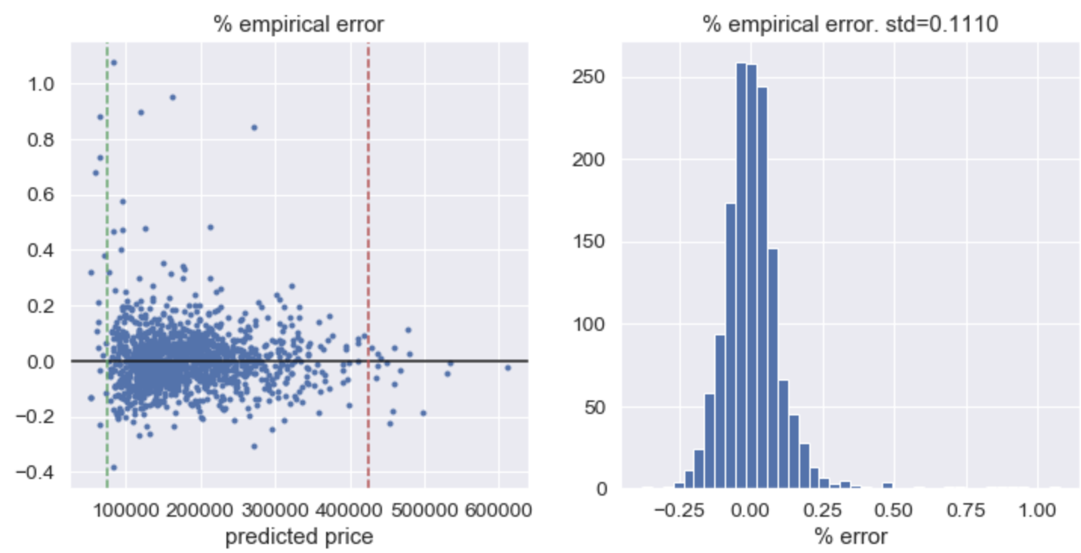
Improvements
Despite a better fit to Ames, model accuracy can still be improved.
Model turns to overprice higher value homes and undershoot at the lower end
Residuals(actual – predicted) show positive and negative biases at the extremes.

Slide 6
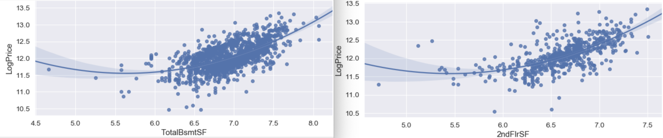
Improvements & Conclusions
Another look at a couple of numerical features confirms the convexity
Feature generation :- include higher orders(polynomials)
Fit specific models to the tails
Might improve accuracy but adds complexity and reduces transparency.
Currently happy with the accuracy vs. complexity balance of existing model
Half of our predictions fell within $5.6k of actual sale prices
Best Kaggle Score: 0.1172

